Slide 1

File Systems in Operating System
20-11-2024

Slide 2
File
A computer file is defined as a medium used for saving and managing data in the computer system. The data stored in the computer system is completely in digital format, although there can be various types of files that help us to store the data.

Slide 3
File System
A File System is an integral part of an OS. A File System is a data structure that stores data and information on storage devices (hard drives, floppy disc, etc.), making them easily retrievable. Different OS’s use different file systems, but all have similar features.
The most important part of the file system is the method used to index files on the hard drive. This index allows the OS to know at any given time where to find a specific file on the hard drive. This index is most typically based on file names. Depending on the operating system there are different file systems, and thus different indexing methods.

Slide 4
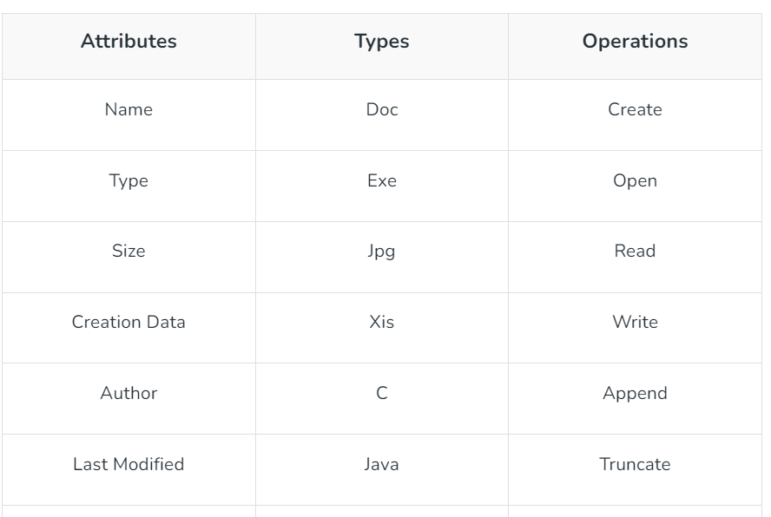
Files Attributes And Their Operations

Slide 5
File allocation methods / Techniques
The allocation methods define how the files are stored in the disk blocks. There are three main disk space or file allocation methods.
Contiguous Allocation
Linked Allocation
Indexed Allocation
The main idea behind these methods is to provide:
Efficient disk space utilization
Fast access to the file blocks

Slide 6
Contiguous Allocation
In this scheme, each file occupies a contiguous set of blocks on the disk. For example, if a file requires n blocks and is given a block b as the starting location, then the blocks assigned to the file will be: b, b+1, b+2,……b+n-1. This means that given the starting block address and the length of the file (in terms of blocks required), we can determine the blocks occupied by the file. The directory entry for a file with contiguous allocation contains
Address of starting block
Length of the allocated portion.
The file ‘mail’ in the following figure starts from the block 19 with length = 6 blocks. Therefore, it occupies 19, 20, 21, 22, 23, 24 blocks.

Slide 7
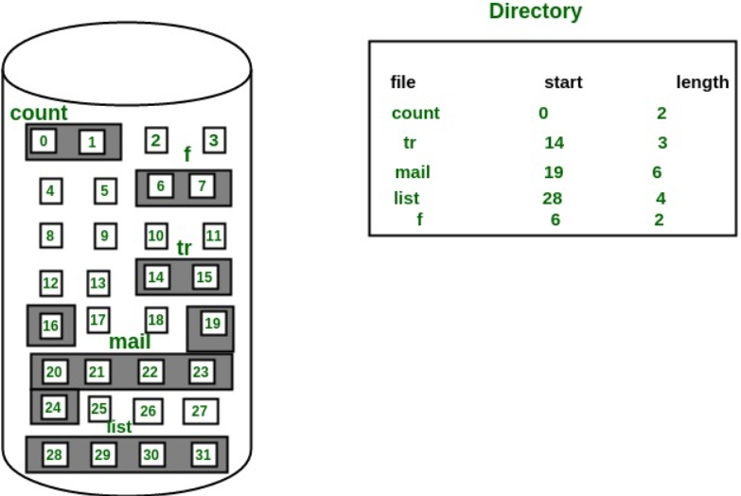
Contiguous Allocation

Slide 8
Windows: 3 file systems
The first is known as the FAT (12, 16, or 32) file system. This system uses what is known as a File Allocation Table to index the files on the disc.
The second file system you may encounter when using Windows is known as NTFS (New Technology File System). NTFS uses binary trees that, while complex, allow for very fast access times.
The third file system, exFAT, is a lightweight file system used primarily in flash storage applications and SD cards. It has large file size and partition size limits, which means you can store files over 4GB on a flash drive or SD card that is formatted with exFAT.

Slide 9
MAC OS
In the macOS environment you will find the HFS+ file system (pronounce it HFS Plus )¹. As of June 2016, Apple has implemented their new file system “APFS”. This has become the replacement for HFS+ on macOS High Sierra and onward, as well as iOS 10.3+.

Slide 10
Linux
Depending on which type of Linux environment you are running, you may run into several different file systems. Some of them are ext2, ext3, and ext4. XFS, JFS, and a few others are also used. ext3 is a journaling² extension to the ext2 file system on Linux. ext4 is the successor to ext3.

Slide 11
Protection in OS : Domain of Protection, Association, Authentication
Need of protection OS :
To ensure data safety, process and program safety against illegal user access, or even program access, we need protection.
It is to ensure that programs, resources and data are accessed only according to the systems’ policies.
It is also to ensure that there are no access rights’ breach, no unauthorized access to the existing data, no virus or worms.
There can be security threats such as unauthorized reading, writing, modification or preventing the system to work properly for the authorized users themselves.

Slide 12
Goals of Protection :
Therefore, protection is a method of safeguarding data and processes against malicious and intentional intrusion. For that purpose, we have protection policies that are either designed by the system itself or specified by the management itself or are imposed by the programmers individually to protect their programs with extra safety.
It also gives a multiprogramming OS the sense of safety that is required by its users to share common space like files or directories.
The policies bind how the processes are to access the resources present in the computer system, resources like CPU, memory, software and even the OS. Both the OS designer and the application programmer are responsible for this. However, these policies always change from time to time.

Slide 13
Thanks

